Slide 1


STCU - Targeted Initiative on CBRN Export Control on Dual-Use Materials and Intangible Technologies in GUAM Countries

Slide 2
This Targeted Initiative is organised in Work Packages, each of them devoted to an especific activity, but at the same time there are synergies between them.
WP2: network of scientists
WP3: academic projects (Master and other courses)
WP4: PhD Grant
WP5: industry outreach, handbooks and Internal Compliance Program

Slide 3
WP3: academic projects
Under this unbrella, we are supporting several academic projects in Ukraine, Georgia and Moldova. Soon a Project will start in Azerbaijan.
The original proposal includes the development of a Master Course on Export Control.

Slide 4
The master program was designed by Dr Jean Pascal Zanders following a modular concept, including the core concepts of CBRN and non proliferation, and export control of dual use goods.
The original design is for a 1 year master course.
The modular design has as objective the possibility of being adapted or customized according to each Parner Country needs.

Slide 5
Structure of the master course original proposal:
Introductory modules (IM)
IM 1: CBRN basic knowledge and concepts
IM 2: Frameworks, instruments and responsibilities
Substantive modules (SM)
SM 1: Threats, risks and their mitigation
SM 2: Transfer controls (general)
SM 3: Transfer controls (national context)
SM 4: Promoting responsible behaviour
Seminar modules
SE 1 (follows SM2)
SE 2 (follows SM3)
SE 3 (follows SM4)

Slide 6
The Economic Security of Entrepreneurship Master Program was launched in 2019 at Taras Shevchenko National University of Kyiv.
The first enrolment to a full-time course took place in 2019. Subsequently, based on the labor market demand, as well as on an inquiry from the Ukrainian Chamber of Commerce and Industry, the Program focus was shifted from academic training to professional distance learning.
During the first year, Visiting Professors (VP) trained the Ukrainian ones in the specific topics. In 2020, the VP advised the local profesors on their first time presenting the modules.
The VP are Dr. Jean Pascal Zanders, Dr. Quentin Michel, Dr. Brett Edwards and Dr. Sonia Drobysz

Slide 7

2019
Full-time
7 applications submitted.
4 students entered and graduated.
Full scholarship
2020
Distance
26 applications submitted.
12 students entered.
Half scholarship
2021
Distance
Over 40 applications submitted
18 students admitted.
No scholarship

Slide 8
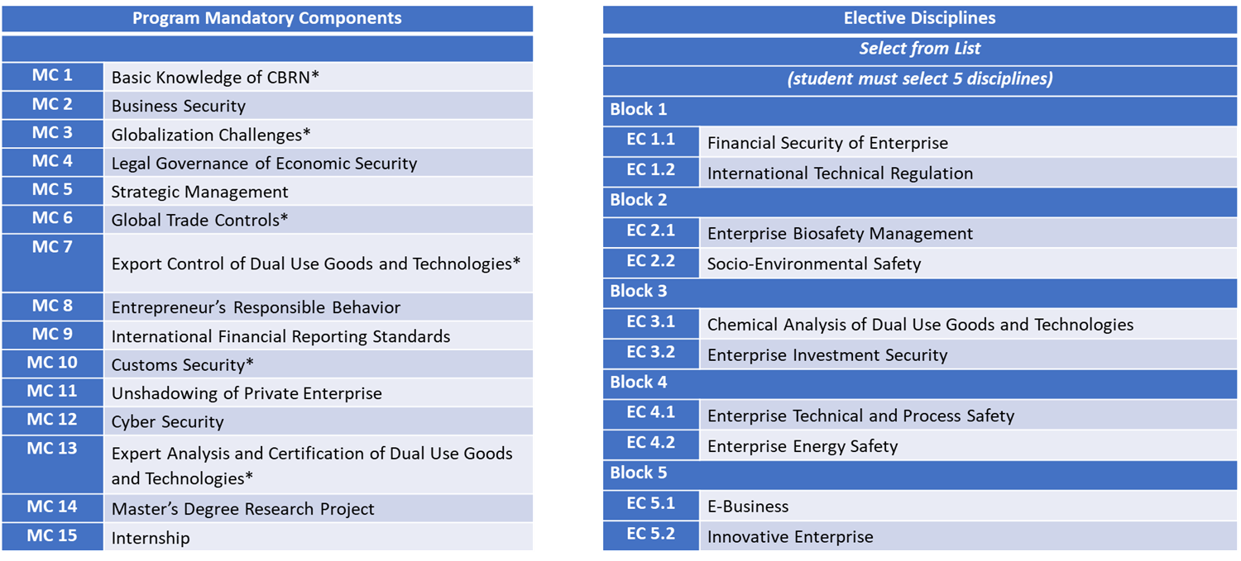

Slide 9
Expansion to other regions:
Currently and because of the interest demostrated by several universities across the country, we are developing cooperation proposals and plans with universities and institutes from several cities.
Administrations of these universities are interested in launching the specific modules (disciplines) devoted to export control and CBRN challenges that constitute the Master program Economic Security of Entrepreneurship (extra-mural form).

Slide 10
Vasyl’ Stus Donetsk National University in Vinnytsia
Zhytomyr Polytechnic State University
Khmelnytskа Humanitarian and Pedagogical Academy
West Ukrainian National University
Ternopil Volodymyr Hnatiuk National Pedagogical University
Ukrainian State University of Chemical Technology
Alfred Nobel University
Oles Honchar Dnipro National University
Odesa National Medical University
Odesa Mechnikov National University
National University of Horticulture in Uman
Pavel Tychyna Uman State Pedagogical University
University of the State Fiscal Service of Ukraine
Poltava National Pedagogical University
Yuriy Fedkovych Chernivtsi National University
Vasyl Stefanyk Precarpathian National University
Izmail State University of Humanities
Military Institute of Taras Shevchenko National University of Kyiv

Slide 11
Moreover, we are working with experts from the Institute for Nuclear Research of National Academy of Sciences of Ukraine to develop and implement an Internal Compliance Program at the Ukrainian NAS.

Slide 12
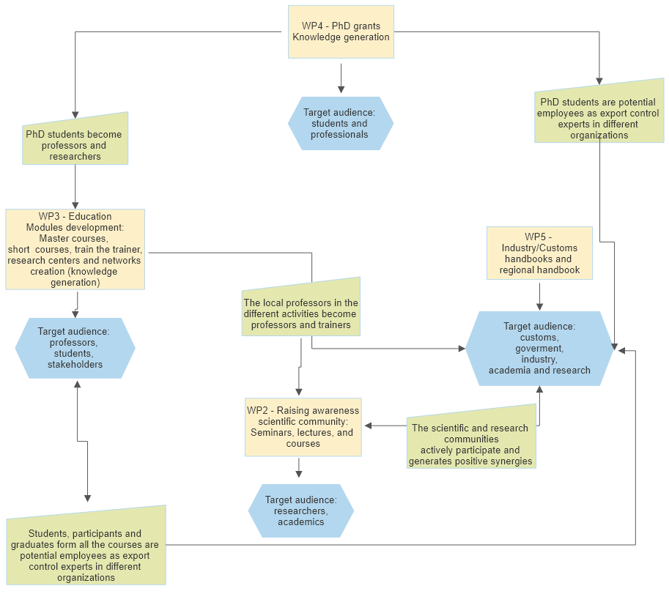

Slide 13
Thank you!
Any questions?

